Slide 1
MutaPLM Embedding Evaluation
07/24/25

Slide 2
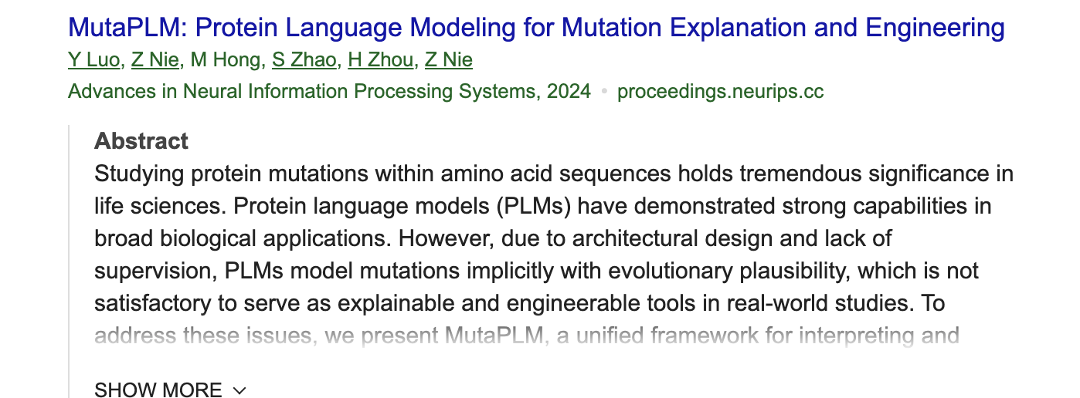

Slide 3
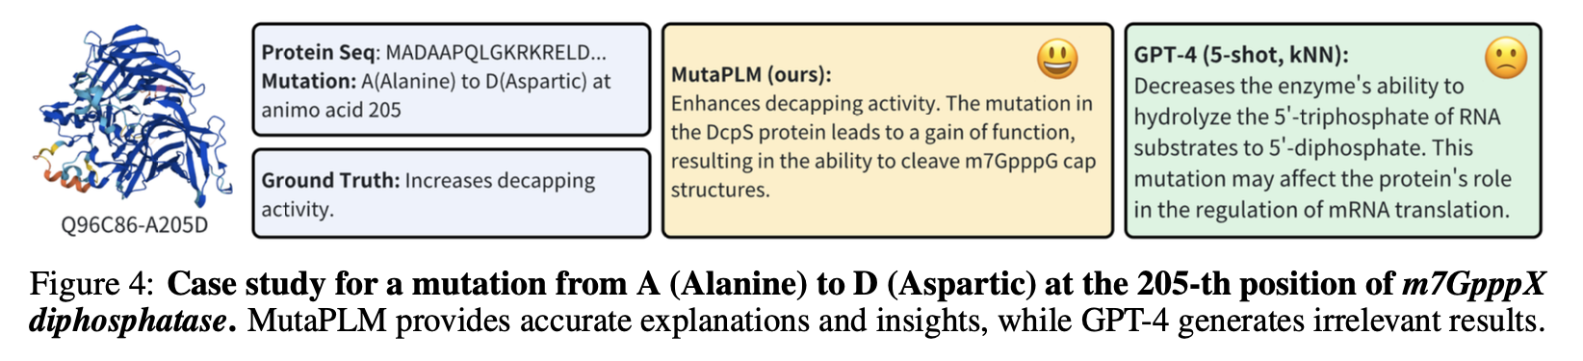
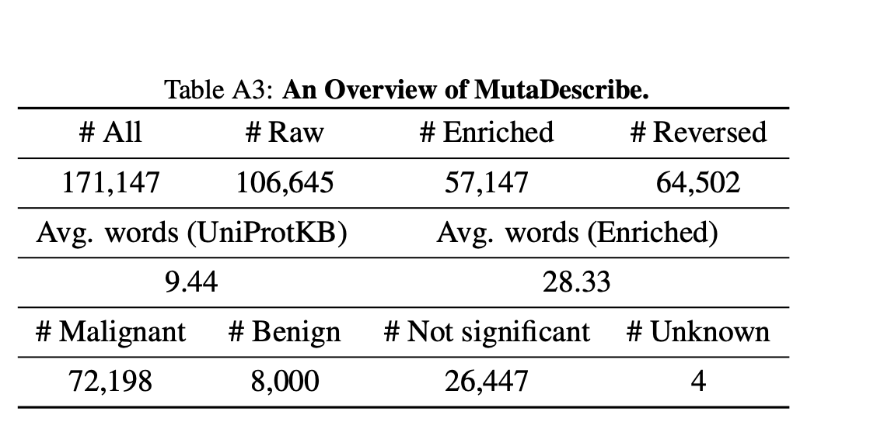
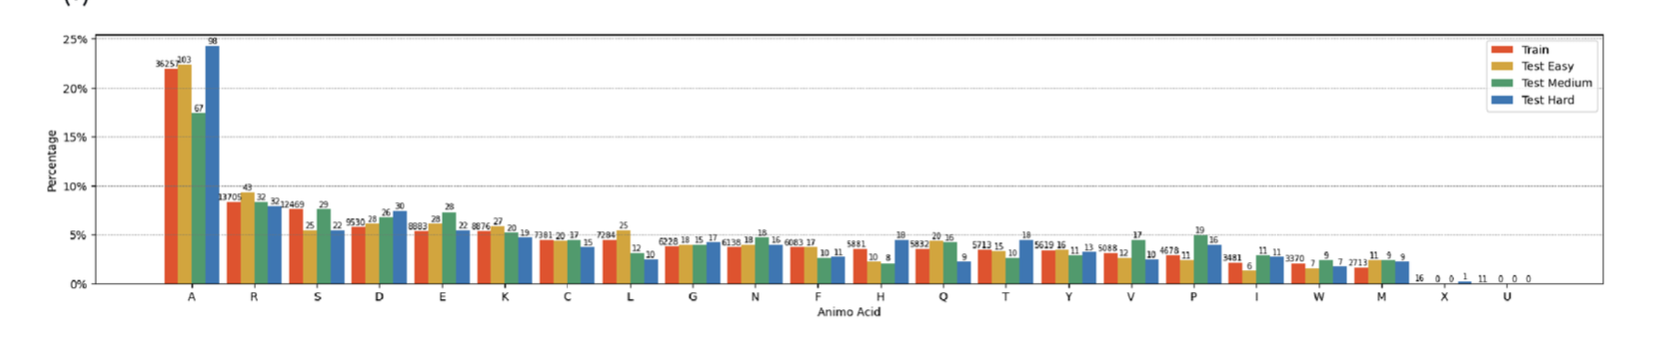
MutaDescribe Dataset (SNVs)

Slide 4
t-SNE Visualization of Wild-Type vs. Mutant Protein Pairs with Cosine Similarity

Slide 5
Comparing t-SNE and UMAP Projections of Wild-Type vs. Mutant Embeddings

Slide 6
UMAP Zoom: Visualizing Local Differences Between WT and Mutant Proteins

